Slide 1
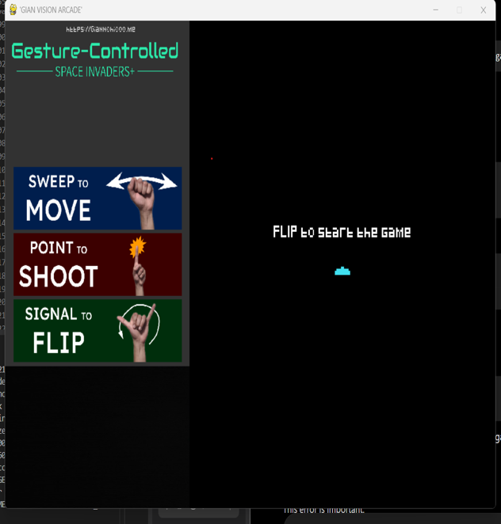





COMPUTER VISION × ARCADE GAME
GianChicoo VISION ARCADE
Gesture-Controlled Space Invaders
SCREENSHOT PLACEHOLDER
A Python arcade game controlled entirely by hand gestures, built with OpenCV for computer vision and PyGame for the game engine.
Gameplay screenshot
(dual-panel window: webcam feed + game arena)
Python
OpenCV
PyGame
NumPy
Aditi Tandon
Python · OpenCV · PyGame · Computer Vision
COVER
ADITI VISION ARCADE | 01
Notes:
Welcome the audience and introduce the project by name: Aditi Vision Arcade, a gesture-controlled Space Invaders-style game. Explain in one sentence what makes it different from a normal arcade game: instead of a keyboard or joystick, the player controls the spaceship purely with hand gestures captured by a webcam. Mention the two pillars of the tech stack — OpenCV for computer vision and PyGame for the 2D game engine — and that the project was built in Python. Set expectations for the presentation: overview, motivation, architecture, the gesture pipeline, a look at the code, the live loop, results, and limitations/future work. Keep this to about 30-40 seconds — it's an introduction, not a deep dive.

Slide 2






PROJECT OVERVIEW
From Webcam to On-Screen Command
The game window is split into two panels: a live webcam feed on the left (with gesture indicators, lives, and score) and the Space-Invaders-style game arena on the right. Hand movement captured by the camera is turned into spaceship movement, shots, and a ship-flip inside the game, in real time.
Webcam
Hand Tracking
Gesture
Command
Game Response
cv2.VideoCapture(0) grabs a live frame
Camera frame analyzed for hand position
Movement / point / flip classified
Gesture mapped to a game action
Ship moves, fires, or flips
Confirmed in main.py
Game class owns score, lives, obstacles, aliens and collisions; start_game() opens the webcam, converts each frame (BGR→RGB, rotate, scale) and blits it into the left panel every loop.
OVERVIEW
ADITI VISION ARCADE | 02
Notes:
Walk through the five-stage pipeline left to right: the webcam captures a frame, hand-tracking locates the hand in that frame, the system classifies which gesture is being made, that gesture is translated into a command, and the game responds. Emphasize that this whole pipeline runs every single frame, which is what gives the illusion of real-time control. Point out the confirmed-in-code callout at the bottom: the game window literally shows the live camera feed on the left, side by side with the game arena on the right, which is a direct result of the frame-conversion code inside start_game(). This slide should feel like the 30,000-foot view before we go deeper into architecture and gesture mapping on later slides.

Slide 3
PROBLEM & MOTIVATION
Why Touchless Input?
Per the project README, the goal was to experiment with computer vision and learn OpenCV in a hands-on, playful way — using gesture recognition as the input method for a classic arcade game format instead of a keyboard or joystick.
Traditional Controllers
Touchless Interaction
Keyboard, mouse, or a physical gamepad
Direct, precise, and low-latency input
Requires dedicated hardware in hand
Input method is fixed and mechanical
Webcam-based hand gestures as input
Explores real-time computer vision hands-on
No extra controller hardware beyond a camera
A playful context for learning OpenCV
MOTIVATION
ADITI VISION ARCADE | 03
Notes:
Frame this slide as the 'why' before the 'how'. On the left, describe the traditional input model everyone knows: keyboard, mouse, or gamepad — precise and mechanical, but it requires dedicated hardware and offers no room to explore vision-based interaction. On the right, describe the approach this project takes instead: turning a webcam into the controller by recognizing hand gestures. Be careful not to overclaim ergonomic or accessibility benefits that aren't documented — stick to the stated motivation from the README, which is learning OpenCV and computer vision in a fun, applied way, using the arcade game as the vehicle for that exploration. This keeps the framing honest: it's a learning project first, and touchless control is the mechanism used to practice CV concepts.

Slide 4
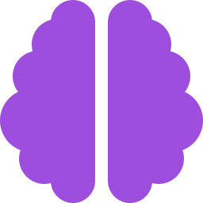

OBJECTIVES
What the Project Set Out to Do
Learn Computer Vision by Building
Build a Playable Arcade Game
Apply OpenCV hand-tracking concepts in a real, hands-on project rather than a tutorial exercise.
Implement a complete, playable Space-Invaders-style game using PyGame — sprites, collisions, scoring, lives.
Map Gestures to Game Actions
Fuse Camera Feed + Game View
Translate three natural hand gestures into concrete commands: move, shoot, and flip.
Render the live webcam feed and the game arena side by side in a single Pygame window.
OBJECTIVES
ADITI VISION ARCADE | 04
Notes:
Present the four objectives as the concrete goals behind the project, each grounded in what the README and code actually show. First, learning computer vision hands-on rather than just following a tutorial. Second, actually shipping a complete, playable arcade game with the standard mechanics — sprites, collisions, scoring, and lives, all of which are implemented in the Game class. Third, mapping exactly three gestures to three actions: move, shoot, and flip — deliberately narrow and focused rather than a large gesture vocabulary. Fourth, the more unusual design objective of fusing the webcam feed and the game arena into one window, which is a distinguishing feature of this project compared to a typical arcade clone. Keep pacing brisk — about 10 seconds per objective.

Slide 5

TECHNOLOGY STACK
Confirmed Dependencies
Confirmed by direct import in main.py and player.py
Python 3
PyGame
OpenCV (cv2)
NumPy
CvZone HandDetector
Confirmed via player.py (Player class)
from cvzone.HandTrackingModule import HandDetector · import numpy as np · import cv2 · from laser import Laser
alien.py, laser.py and obstacle.py are imported by main.py but were not included in the reviewed files, and no requirements.txt was provided — so exact package versions are still not confirmed.
TECH STACK
ADITI VISION ARCADE | 05
Notes:
Be precise about sourcing on this slide, since it's easy to overstate a tech stack. The top row — Python, PyGame, OpenCV, NumPy, and CvZone's HandDetector — is now directly confirmed: main.py imports pygame and cv2, and player.py imports cv2, numpy, and cvzone.HandTrackingModule.HandDetector by name. The code line shown is copied verbatim from player.py's import statements. The callout box at the bottom is still important: three supporting modules — alien, laser, and obstacle — were not part of the reviewed files, and there was no requirements.txt, so exact versions still can't be confirmed. This transparency is intentional — it keeps every claim traceable to a source.

Slide 6
SYSTEM ARCHITECTURE
How the Modules Fit Together
main.py
player.py
cv2.VideoCapture(0)
Player
Game class + start_game() loop
Owns its own cv2.VideoCapture(0) + CvZone HandDetector; ship position, shooting, and flip state
Opened twice: once in start_game() (main.py) and again inside Player.__init__() — only the Player copy is actually read from.
Score & lives HUD
Obstacle setup
Alien setup & movement
Collision checks
Win / lose state
alien.py
Alien / Extra
Enemy sprites, rows, colors, values (not in reviewed files)
laser.py
Laser
Pygame Display Window
Player & alien projectiles (not in reviewed files)
Split view: video panel (left, width = video_width) + game arena (right, width = screen_width)
obstacle.py
Obstacle
Destructible block shields (not in reviewed files)
ARCHITECTURE
ADITI VISION ARCADE | 06
Notes:
Walk through the architecture left to right. main.py is the orchestrator: it defines the Game class, which owns the score, lives, obstacles, alien grid, collision logic, and win/lose state — all of that is directly visible in the provided source. In the middle are the four supporting modules main.py imports: player, alien, laser, and obstacle. Now that player.py has been reviewed, we know it owns its own separate webcam capture object and a CvZone HandDetector instance, and it's fully responsible for ship movement, shooting, and the flip mechanic. The other three — alien, laser, obstacle — still weren't part of the reviewed files, so only their usage from main.py's calls is confirmed. On the right are the two external touchpoints: the OpenCV video capture, and the Pygame display window itself, which main.py explicitly splits into a video panel on the left and the game arena on the right using video_width and screen_width. This slide sets up the next slide, which zooms into the gesture-recognition side specifically — now fully confirmed from player.py.

Slide 7

CV / GESTURE RECOGNITION PIPELINE
From Pixels to Player Intent
Now confirmed directly in player.py — the Player class runs its own capture + detection pipeline, separate from the frame main.py displays.
1
2
3
4
5
Capture Frame
Detect Hand
Read Landmarks
Classify Gesture
Emit Command
self.cap.read() from Player's own cv2.VideoCapture(0), flipped horizontally.
HandDetector(detectionCon=0.8, maxHands=1).findHands(img, draw=False)
detector.fingersUp(hand) returns a 5-value [thumb,index,middle,ring,pinky] list.
fingers[1]==1 → shoot; fingers==[0,0,0,0,1] → flip; else → move.
get_input() fires the laser or flips the ship, subject to a 300ms cooldown.
Confirmed in main.py (display side only)
The frame main.py shows on screen (from game.player_sprite.img) is separately flipped, converted BGR to RGB, rotated 90°, wrapped as a Pygame surface, and scaled to fit the video panel — this is confirmed in start_game(), independent of the detection copy above.
GESTURE PIPELINE
ADITI VISION ARCADE | 07
Notes:
This slide explains how a raw camera frame becomes an in-game command, and it's now fully confirmed against player.py. The Player class opens its own webcam capture in __init__, separate from the one main.py opens. Every update, read_fingers() reads a frame, flips it, and runs it through a CvZone HandDetector configured with detectionCon=0.8 and maxHands=1. detector.fingersUp() returns a five-element list representing thumb, index, middle, ring, and pinky. The classification logic is a simple if/elif/else: if the index finger is up, it's a shoot; if the fingers list exactly matches [0,0,0,0,1] — only the pinky up — it's a flip; anything else defaults to move, since hand position is tracked continuously regardless of which gesture is active. Finally, get_input() actually fires the laser or triggers the flip, each gated by a 300-millisecond cooldown so a held gesture doesn't repeat every single frame. The bottom callout is a separate, second detail: the video the player actually sees on screen goes through its own display-only transform inside start_game(), independent of this detection pipeline.

Slide 8


GESTURE → ACTION MAPPING
Three Gestures, Three Commands
Move Hand Horizontally
Move Spaceship Left / Right
Confirmed in player.py: read_fingers() maps the hand's x-position to self.rect.x every frame the hand is visible — regardless of which gesture is active.
Point With Index Finger
Fire a Laser
Confirmed in player.py: triggers when fingers[1] == 1 (index finger up). get_input() then calls shoot_laser(), gated by a 300ms cooldown.
"Thumb + Pinky" Gesture
Flip Ship to Face the Other Side
Confirmed in player.py: triggers when fingers == [0,0,0,0,1] — only the pinky finger is up. get_input() then calls flip(), gated by a 300ms cooldown.
Note: the README describes "raise your thumb and pinkie finger" for flip; the code checks fingers == [0,0,0,0,1] — pinky up, thumb DOWN. Worth verifying against the actual hand pose.
GESTURE MAPPING
ADITI VISION ARCADE | 08
Notes:
Go through the three gestures one at a time — this is now fully confirmed against player.py rather than just documented. First, horizontal hand movement continuously maps to the ship's x position via read_fingers(), every single frame the hand is visible, independent of whatever gesture is layered on top. Second, pointing with the index finger fires a laser: the exact check is fingers[1] == 1, and get_input() calls shoot_laser() subject to a 300-millisecond cooldown so it doesn't fire every frame while held. Third, the flip gesture: the code checks fingers == [0,0,0,0,1], meaning only the pinky is up and the thumb is down. This is worth calling out honestly if asked — the README describes 'raise your thumb and pinkie finger', but the literal code condition requires the thumb DOWN. This could be due to how detection reads the thumb depending on hand orientation, or it could be worth re-testing physically — either way, it's a genuine, precise discrepancy between the documentation and the implementation, and flagging it shows careful code reading rather than guessing.

Slide 9
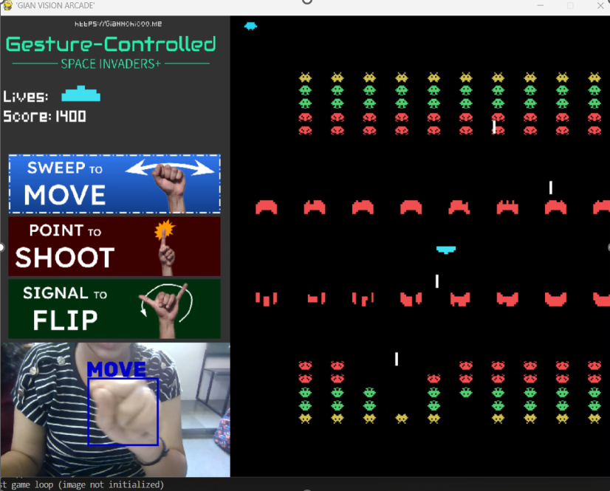
GAME INTERFACE
Reading the Screen
1
Video Feed Panel
Left side — live webcam feed, scaled into the window (video_width x video_height).
2
Live Gesture Box + Label
Confirmed in player.py: a colored cv2 rectangle + "SHOOT"/"FLIP"/"MOVE" text is drawn around the hand in real time (blue/green/red).
3
Gesture Indicator Overlays
move0/shoot0/flip0 images sit static; player.py swaps in a highlighted move1/shoot1/flip1 for whichever gesture is active.
4
Lives & Score HUD
SCREENSHOT PLACEHOLDER
Rendered with the Pixeled.ttf font via display_lives() and display_score().
Full gameplay window
(video panel + game arena)
5
"Out of Scope" Warning
Shown when player.py's read_fingers() finds no hand in frame, setting in_scope to False.
6
Game Arena
Right side — two mirrored alien grids, destructible obstacles, and the player ship.
INTERFACE
ADITI VISION ARCADE | 09
Notes:
This slide is meant to be paired with an actual gameplay screenshot — the placeholder marks exactly where that should go before presenting live. Walk through the labeled elements on the right, all confirmed directly in code. The video feed panel shows the raw webcam input. On top of that, player.py draws a live colored bounding box around the detected hand with a text label — blue for SHOOT, green for FLIP, red for MOVE — giving the player direct visual feedback on what gesture is being read right now. Separately, there are static instruction images (move0, shoot0, flip0) that get swapped for a highlighted version (move1, shoot1, flip1) depending on which gesture is currently active — so the instructions panel itself lights up to match. The lives and score HUD is rendered in the custom Pixeled font, and the 'hands out of camera scope' warning appears specifically when player.py's read_fingers() fails to find a hand in the frame. Finally, the game arena on the right has its two mirrored rows of aliens and destructible obstacles. Once the real screenshot is dropped in, these callouts should line up with what's on screen.

Slide 10
IMPLEMENTATION HIGHLIGHTS
Real Snippets From main.py & player.py
def alien_shoot(self):
if self.aliens.sprites():
random_alien = choice(self.aliens.sprites())
if random_alien.flipped:
laser_sprite = Laser(
random_alien.rect.center, -6, screen_height)
else:
laser_sprite = Laser(
random_alien.rect.center, 6, screen_height)
self.alien_lasers.add(laser_sprite)
def collision_checks(self):
for laser in self.player.sprite.lasers:
aliens_hit = pygame.sprite.spritecollide(
laser, self.aliens, True)
if aliens_hit:
for alien in aliens_hit:
self.score += alien.value
laser.kill()
self.explosion_sound.play()
Alien Shooting
Scoring on Hit
def run(self):
self.player.update()
if self.player_sprite.game_state == 0:
self.start_message(); return
if self.player_sprite.game_state == 2:
self.death_message(); return
if self.player_sprite.game_state == 3:
start_game(); return
def read_fingers(self):
...
self.fingers = detector.fingersUp(hand)
if self.fingers[1] == 1:
... # draw 'SHOOT' box (blue)
elif self.fingers == [0,0,0,0,1]:
... # draw 'FLIP' box (green)
else:
... # draw 'MOVE' box (red)
State Machine in run()
Gesture Classification (player.py)
CODE HIGHLIGHTS
ADITI VISION ARCADE | 10
Notes:
These four snippets are copied directly from the provided source, chosen to show the most important gameplay and gesture mechanics. Top left: alien_shoot() picks a random alien and fires a laser in a direction determined by whether that alien belongs to the flipped (mirrored) row or not — this is the core of the dual-sided shooting mechanic. Top right: collision_checks() shows how a player's laser hitting an alien increases the score by that alien's value, kills the laser, and plays the explosion sound. Bottom left: the run() method is essentially a small state machine driven by player_sprite.game_state — state 0 shows the start message, state 2 shows the death message, and state 3 restarts the game by re-calling start_game(). Bottom right, now from player.py: this is the actual gesture classification logic — fingersUp() gives a list of which fingers are raised, and the code branches into shoot, flip, or move based on that list, drawing a matching colored box and label on the camera feed for each case. If asked in a viva to explain any of these, walk through them line by line — they map directly onto the mechanics already discussed on earlier slides.

Slide 11
REAL-TIME GAME LOOP
Inside start_game()
1
Poll Events
pygame.event.get() handles QUIT and the custom ALIENLASER timer event (fired every 800ms via pygame.time.set_timer).
2
Grab & Transform Frame
Read game.player_sprite.img, flip horizontally, convert BGR to RGB, rotate 90°, wrap as a Pygame surface, scale to the video panel.
3
Draw HUD & Overlays
Blit the background, logo, and gesture-instruction images (move0 / shoot0 / flip0) plus the website credit line.
4
game.run()
Update sprites, run collision checks, draw obstacles/aliens/lasers, and check win/lose state.
5
display.flip()
Present the fully composed frame to the window.
6
clock.tick(60)
Cap the loop rate at 60 — a frame-rate ceiling, not a measured or benchmarked FPS.
GAME LOOP
ADITI VISION ARCADE | 11
Notes:
This slide traces exactly one iteration of the while-loop inside start_game(), in the order it happens in code. First, Pygame events are polled — the window's QUIT event, and a custom ALIENLASER event that's set up as an 800-millisecond repeating timer and only actually triggers alien_shoot() while the game is in its playing state. Second, the current camera frame is grabbed and transformed — flipped, converted from BGR to RGB, rotated, wrapped into a Pygame surface, and scaled to fit the video panel. Third, the HUD and overlay images are drawn: the logo and the three gesture-instruction images. Fourth, game.run() does the actual gameplay update — moving sprites, checking collisions, drawing the arena, and checking for a win or loss. Fifth, display.flip() presents everything to the screen. And finally, clock.tick(60) caps how fast this loop can repeat — it's important to be precise here: this sets an upper bound on the frame rate, it is not a measured performance number, and no FPS benchmark was run or is being claimed.

Slide 12

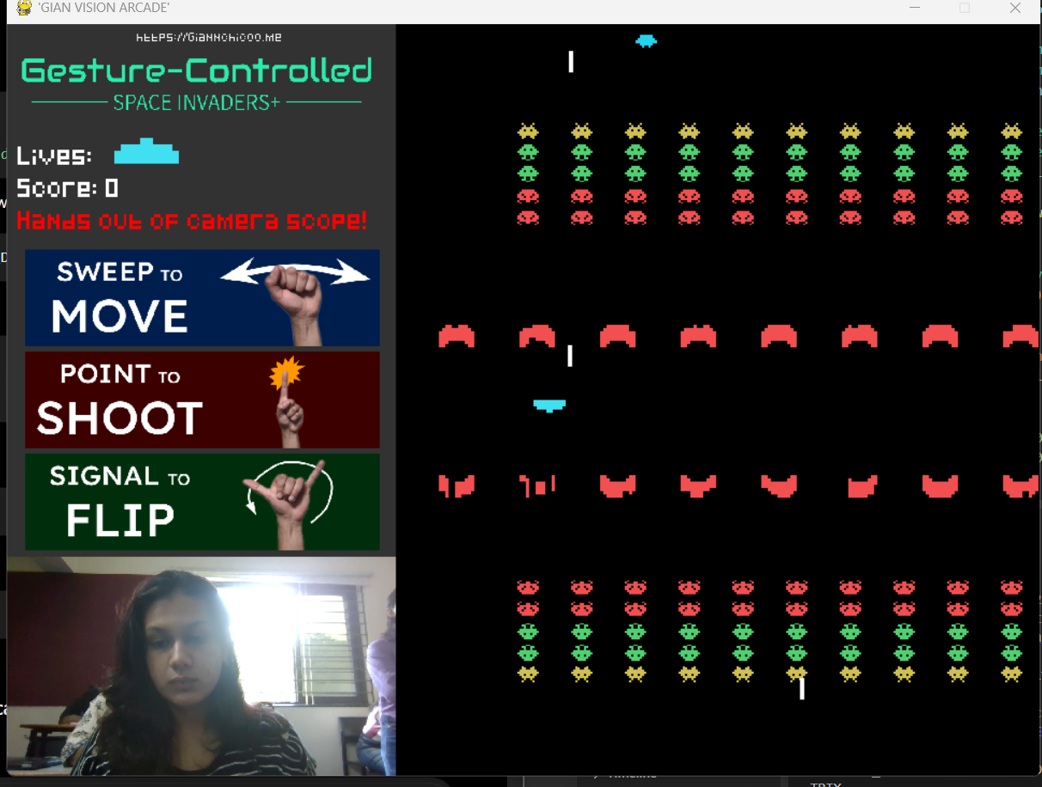
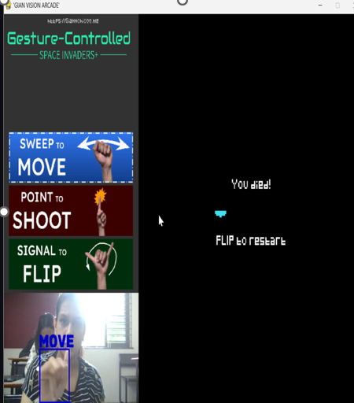
WORKING PROTOTYPE / RESULTS
What the Playable Build Looks Like
SCREENSHOT PLACEHOLDER
SCREENSHOT PLACEHOLDER
SCREENSHOT PLACEHOLDER
"FLIP to start the game" prompt (game_state == 0)
Dual-panel view — video feed + game arena
"You won" or "You died!" (game_state == 2 or 4)
Start Screen
Active Gameplay
Win / Death Screen
No FPS, latency, or gesture-detection accuracy figures were measured or are claimed. clock.tick(60) only caps the render-loop rate — it is not a performance benchmark.
RESULTS
ADITI VISION ARCADE | 12
Notes:
This is where the three real gameplay screenshots go once available — start screen, active gameplay, and the win or death screen, all tied to the specific game_state values used in the code (0 for start, 2 for death, 4 for victory). The important thing to communicate here, especially in a viva setting, is the disclaimer at the bottom: this presentation does not claim any FPS number, latency figure, or gesture-recognition accuracy percentage, because none of that was actually measured. The only related detail confirmed in code is clock.tick(60), which simply caps how fast the render loop is allowed to run — it is a ceiling, not a benchmark result. Being upfront about this avoids an easy follow-up question from an evaluator: 'what was your measured FPS?' — the honest answer is that no such measurement was taken.

Slide 13


LIMITATIONS & FUTURE SCOPE
What Exists Today vs. What Could Come Next
Current Limitations
Future Scope (Not Implemented)
Only one level exists — confirmed in main.py (no level-progression logic) and stated directly in the README.
A ship-alien collision calls pygame.quit() / sys.exit() directly in collision_checks() — an abrupt exit, not a graceful game-over screen.
Two separate cv2.VideoCapture(0) objects are opened (one in main.py's start_game(), one in Player.__init__()) — only the Player copy is actually read from.
Several images (logo, gesture overlays in main.py; shoot1/flip1/move1 in player.py) are reloaded from disk every loop iteration rather than once at startup.
The flip-gesture code (fingers == [0,0,0,0,1]) doesn't exactly match the README's "raise thumb and pinky" description — the check requires the thumb down.
Camera resolution is hardcoded to 1920x1080 in two places, with no visible fallback if that resolution is unavailable.
Multiple levels and difficulty progression
Graceful pause / game-over flow instead of a hard process exit
A single, shared webcam capture object instead of two independent ones
Configurable camera resolution with error handling for an unavailable webcam
Re-verify the flip gesture against the README's description, or update the docs to match the code
Asset pre-loading/caching to avoid per-frame disk reads
Packaging as a standalone, cross-platform executable
LIMITATIONS
ADITI VISION ARCADE | 13
Notes:
Keep a clean line between the two columns on this slide — one is what exists today, verified against the code; the other is ideas for later, explicitly not implemented. On limitations: there's only one level, which both the code structure and the README confirm directly. A collision between an alien and the player doesn't lead to a game-over screen — it calls pygame.quit() and sys.exit() directly. Two separate webcam capture objects get opened — one in main.py that's essentially unused, and one inside Player that does all the real work — which is a bit wasteful. Several images get reloaded from disk every single loop iteration in both main.py and player.py, rather than being loaded once at startup. The flip gesture's code doesn't exactly match its written description in the README. And the camera resolution is hardcoded in two places with no fallback. On future scope, be clear these are proposals, not features: multiple levels, a proper pause and game-over flow, consolidating to one webcam object, configurable camera handling, resolving the gesture-description mismatch, asset caching for efficiency, and eventually packaging it as a standalone executable. If a viva examiner asks 'what happens when you lose?' this slide has the precise, code-verified answer: it currently force-quits the program rather than showing a game-over screen.

Slide 14

CONCLUSION
SEE
UNDERSTAND
CONTROL
Aditi Vision Arcade demonstrates a complete, playable arcade game controlled entirely by hand gestures — combining a live computer-vision feed with a classic Space-Invaders-style engine in a single Pygame window.
Thank You
Aditi Tandon Riya Sharma
CONCLUSION
ADITI VISION ARCADE | 14
Notes:
Close on the SEE-UNDERSTAND-CONTROL framing: the webcam sees the hand, the computer-vision pipeline understands what gesture is being made, and that understanding controls the spaceship in real time — it's a clean way to summarize the whole pipeline in three words. Reiterate the single strongest, most defensible summary line: this project is a complete, playable arcade game controlled entirely by hand gestures, combining a live camera feed with a classic Space-Invaders-style engine in one window — both of those claims are directly backed by the code reviewed. Thank the audience or examiners and invite questions — this transitions naturally into the viva Q&A slide that follows, if it's included in this presentation.

Slide 15

VIVA VOCE — Q&A PREP
Anticipated Questions & Grounded Answers
What role does OpenCV play here?
Two roles, both confirmed: player.py uses cv2.VideoCapture to read webcam frames for gesture detection; main.py separately uses cv2 to transform a frame (color conversion, rotation, scaling) for on-screen display.
How is the hand tracked?
Confirmed in player.py: cvzone.HandTrackingModule.HandDetector(detectionCon=0.8, maxHands=1), called via findHands() each frame, with fingersUp() returning which fingers are raised.
How are gestures classified?
Confirmed in player.py: fingers[1]==1 → shoot; fingers==[0,0,0,0,1] (only pinky up) → flip; anything else → move. Hand x-position is tracked continuously regardless of gesture.
Does the flip gesture match the README?
Not exactly — the README says "raise thumb and pinky", but the code requires the thumb DOWN and only the pinky up. Worth testing the real hand pose to confirm which is accurate.
What does Pygame handle?
The entire game engine: sprites (player, aliens, lasers, obstacles), collision detection, scoring, the HUD, and the display window itself.
Walk me through one loop iteration.
Poll events → grab & transform the camera frame → draw HUD/overlays → game.run() (update, collide, draw, check win/lose) → display.flip() → clock.tick(60).
Is this project "AI"?
It uses computer-vision techniques (HandDetector-based tracking + rule-based finger-state checks) rather than a custom-trained ML model — no dataset or training process is present in the reviewed files.
VIVA Q&A
ADITI VISION ARCADE | 15
Notes:
This slide is a rapid-fire prep sheet for a viva or Q&A session, not something to read aloud verbatim. Skim through each question and answer pair so they're fresh — OpenCV's dual role (capture for detection, transform for display), exactly how hand tracking and gesture classification work per player.py, the honest discrepancy between the documented and coded flip gesture, what Pygame is responsible for, a one-line walkthrough of the game loop, and the important distinction that this project uses computer-vision techniques rather than a custom-trained AI/ML model. That last point is worth emphasizing on its own: there is no dataset, training process, or model file anywhere in the project — it's classic computer vision (HandDetector-based tracking) plus simple rule-based finger-state checks driving a rules-based game, not machine learning built from scratch for this project. Encourage the audience to ask follow-ups on anything here; every answer is traceable to main.py or player.py, and the one open question — whether the flip gesture is supposed to require the thumb down — is called out honestly rather than guessed at.

